Slide 1
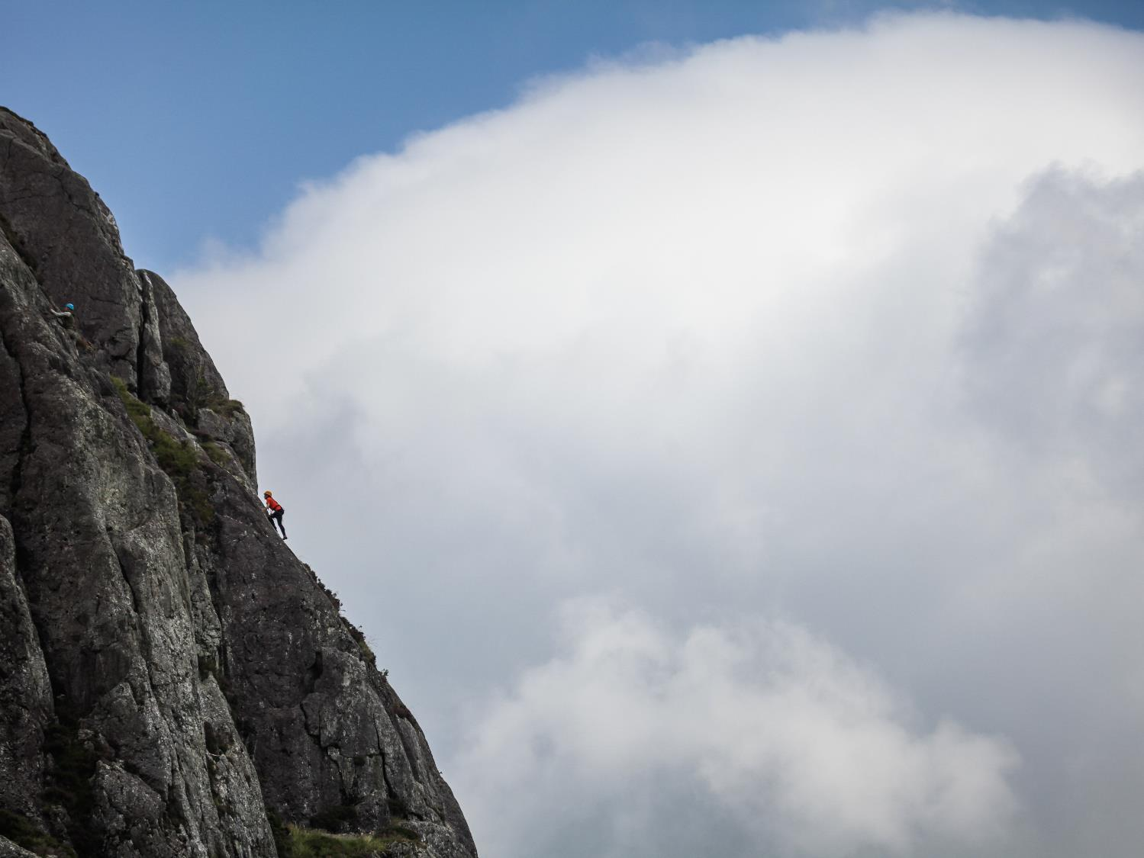
Outward Bound
Helping young people reach new heights since 1941.
Presenters name

Slide 2
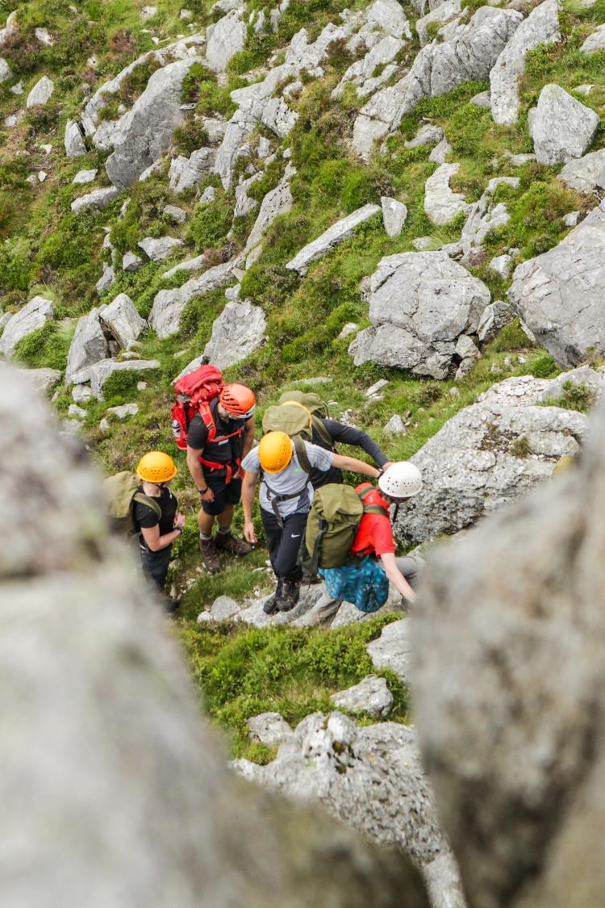
Why Outward Bound?
More than
you
think
The Outward Bound Trust is an educational charity that helps young people defy limitations through learning and adventures in the wild.

Slide 3
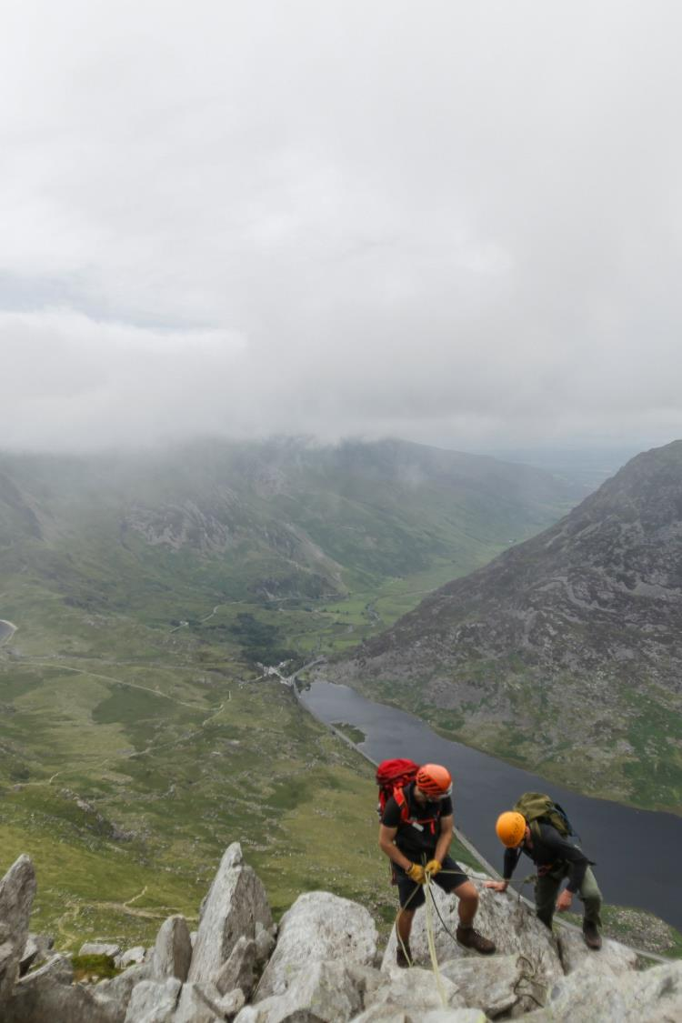
Why Outward Bound?
More than
you
think
The Outward Bound Trust is an educational charity that helps young people defy limitations through learning and adventures in the wild.
Partnering with schools, colleges, employers and youth groups to teach the most important lesson anyone could ever learn: to believe in themselves.

Slide 4
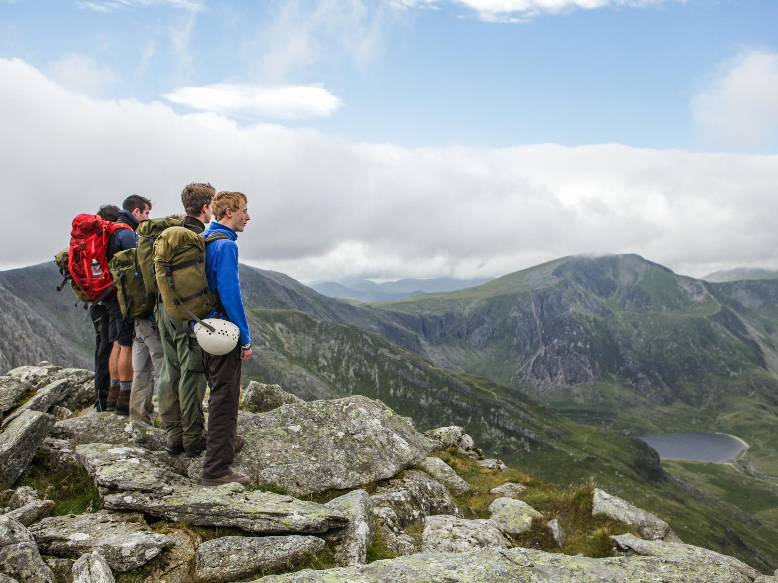

Slide 5
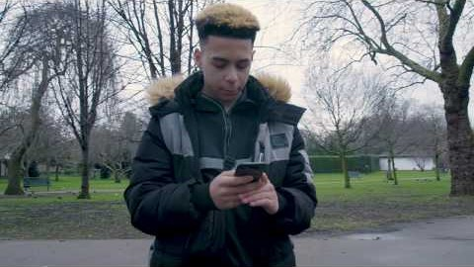

Slide 6
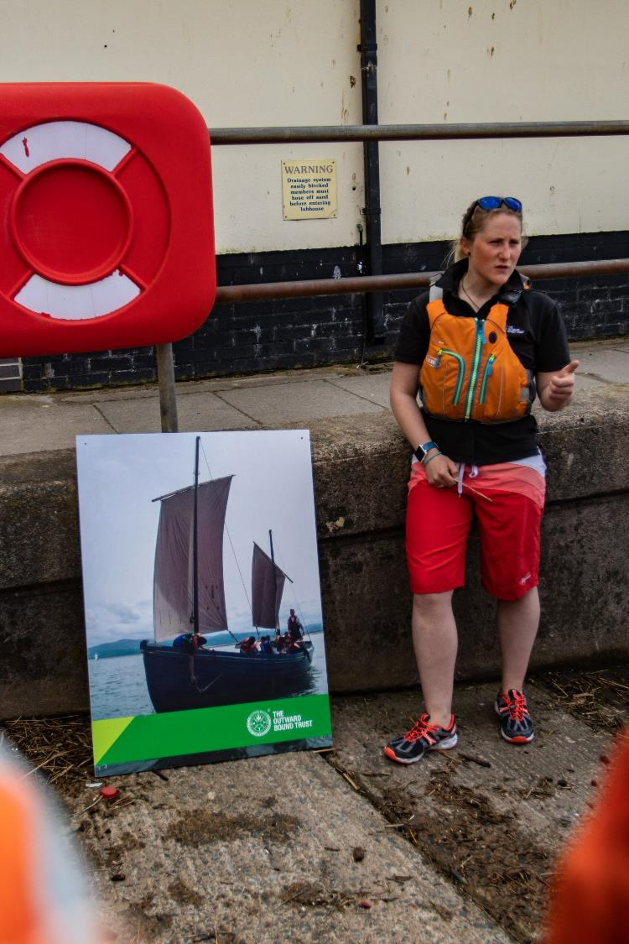
An alternative
EDUCATION
Outward Bound’s programmes deliver an alternative education, giving young people the skills and confidence to face real world challenges head on.
Creating opportunities for all young people, no matter their background or ability.

Slide 7
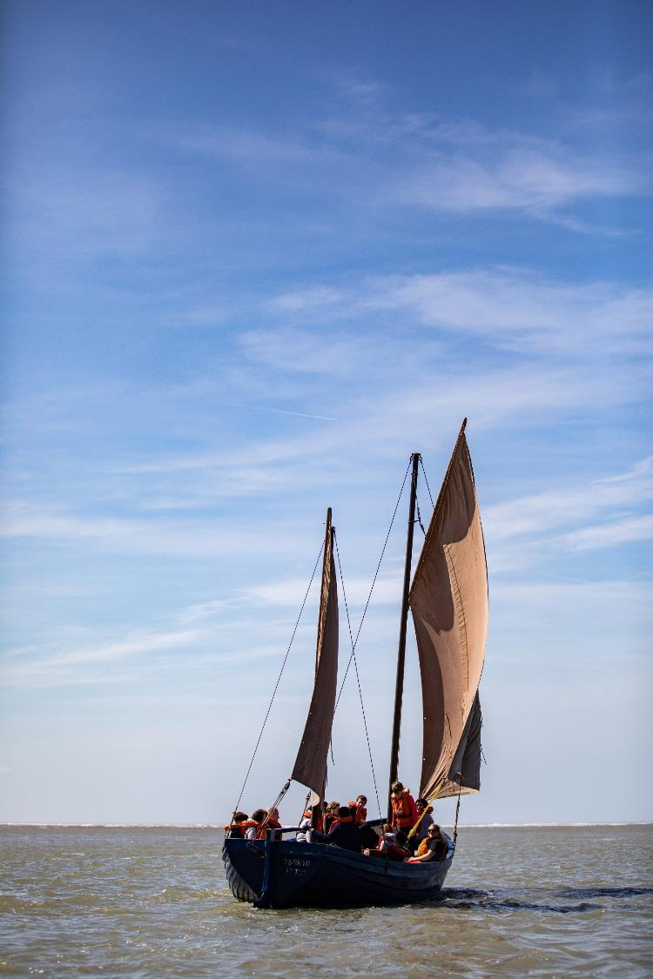
AN ALTERNATIVE
EDUCATION
Outward Bound’s programmes deliver an alternative education, giving young people the skills and confidence to face real world challenges head on.
Creating opportunities for all young people, no matter their background or ability.
Outward Bound work with funders to help remove roadblocks that would otherwise prevent some from taking part and realising their full potential.

Slide 8
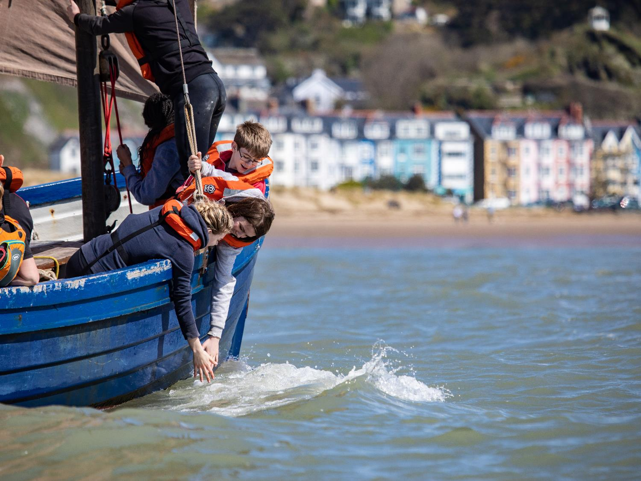

Slide 9
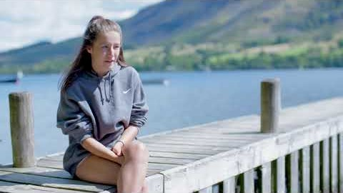
Lauren’s story

Slide 10
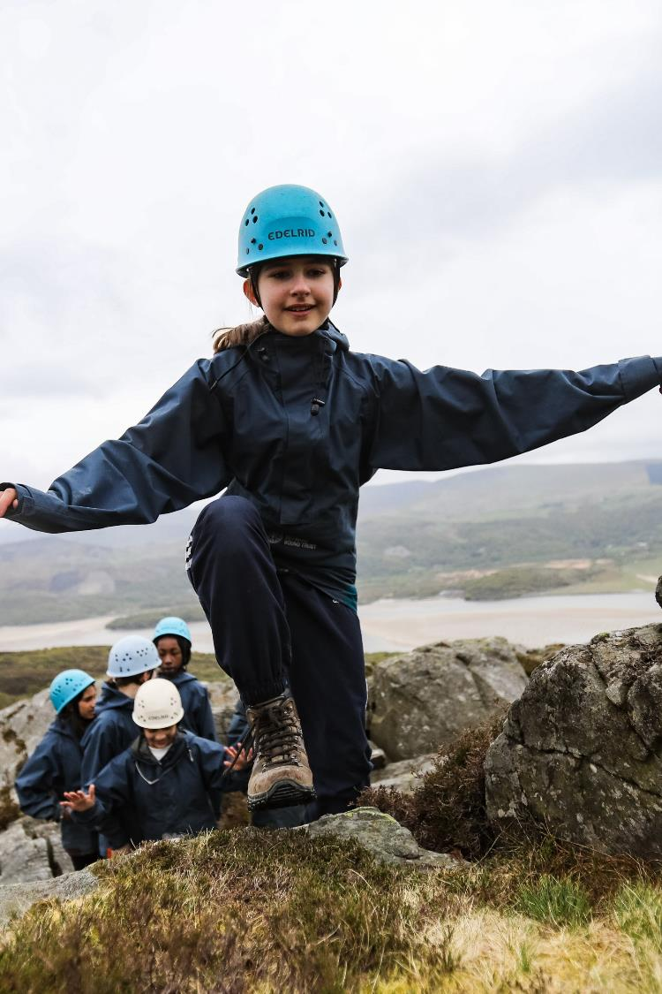
Acclaimed for promoting positivity and confidence, Outward Bound invites young people to scale mental mountains. Because emotional well-being is just as important as physical fitness.
A different
Kind of
teacher

Slide 11
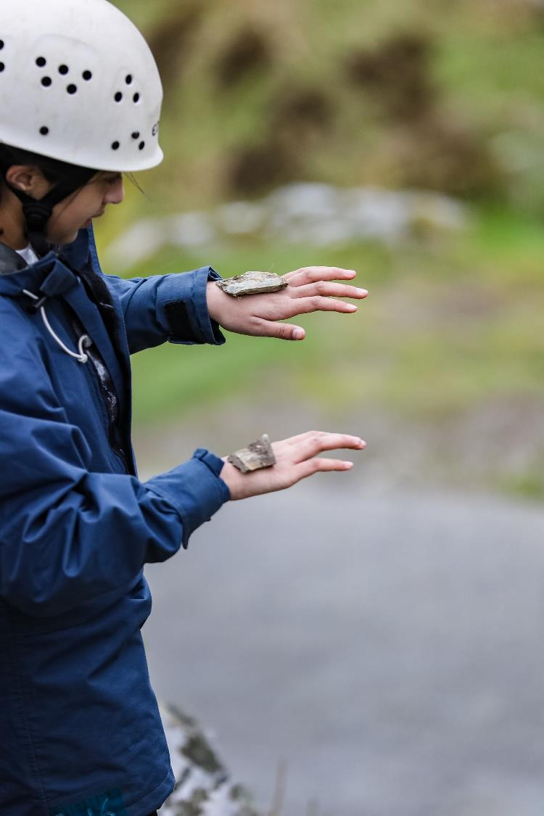
Acclaimed for promoting positivity and confidence, Outward Bound invites young people to scale mental mountains. Because emotional well-being is just as important as physical fitness.
Meaning that when participants returns home, they can say they’ve been transformed into someone they never thought possible.
A different
Kind of
teacher

Slide 12
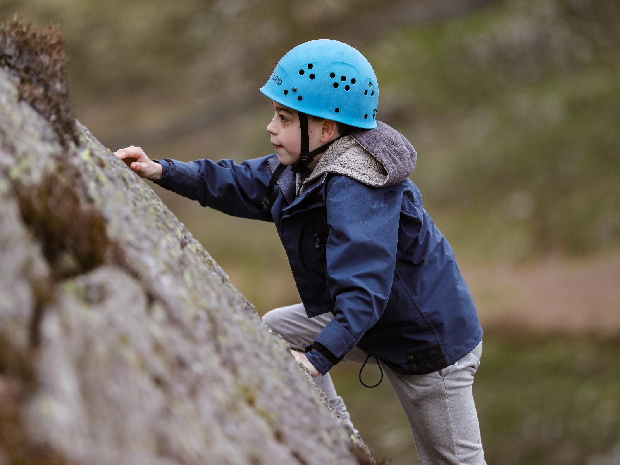

Slide 13
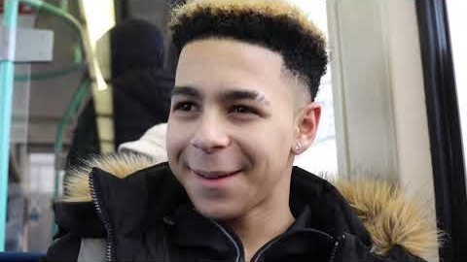
Ryan’s story

Slide 14
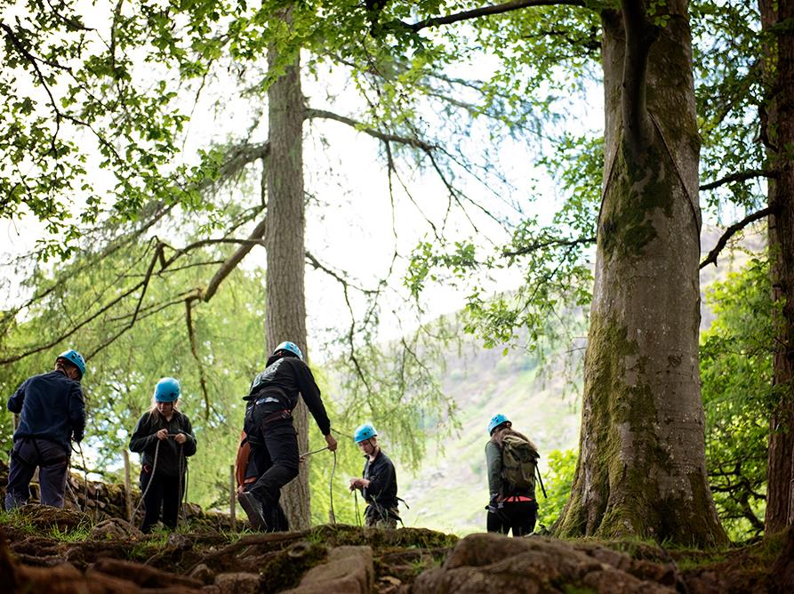
The skills I’ve learned mean that I can and will spend time in the outdoors, but they also make me a better person in everything I do.
Jared, 14

Slide 15
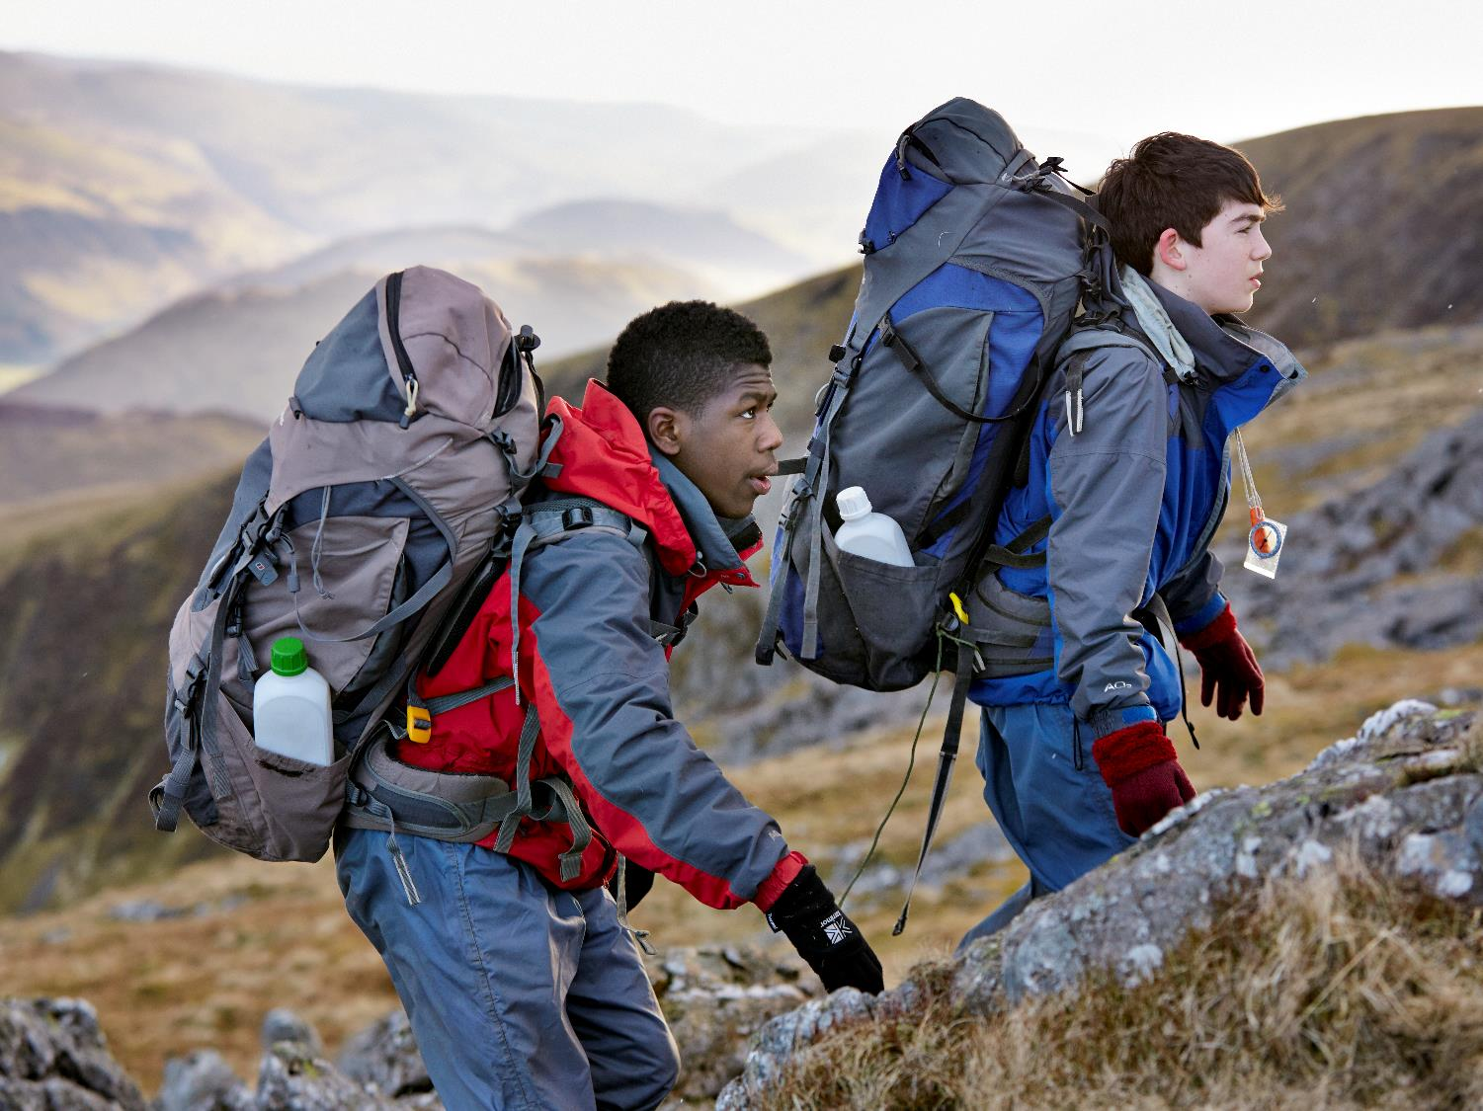
This has given me a new lease of life; it has changed my perception of the world and the way I react to everything.
Oliver, 16

Slide 16
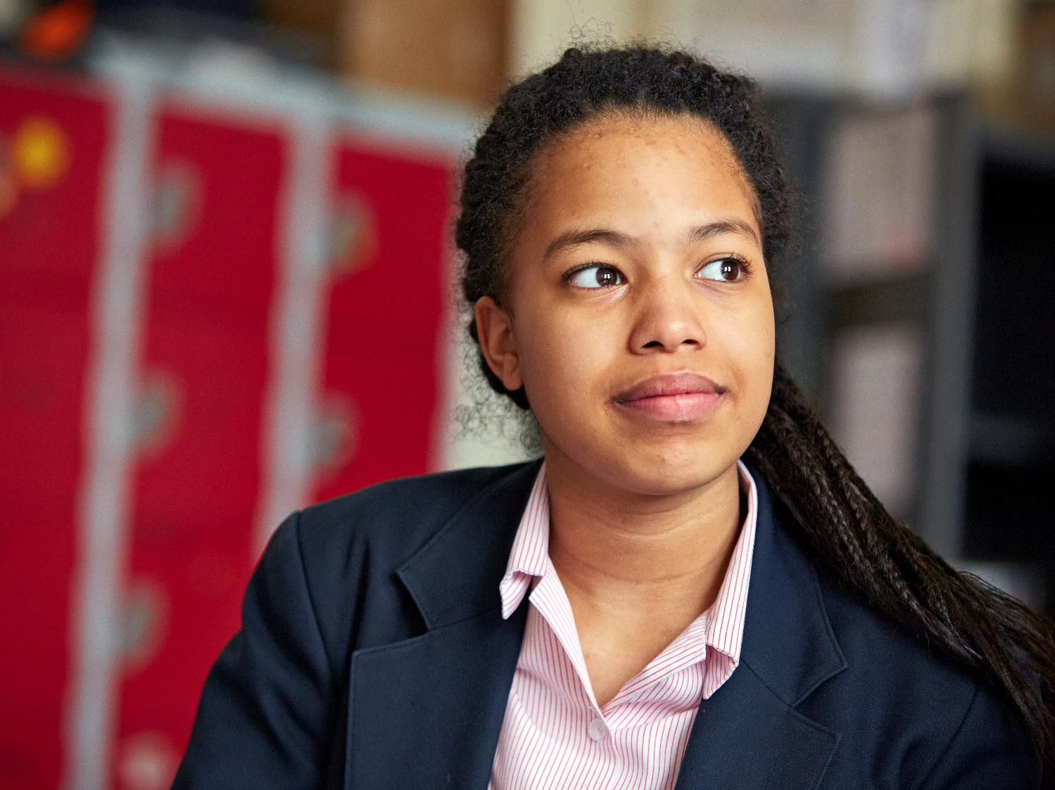
It’s difficult to describe all the emotions you go through at Outward Bound. You feel like a new person when you get back to school.
Rose, 15

Slide 17
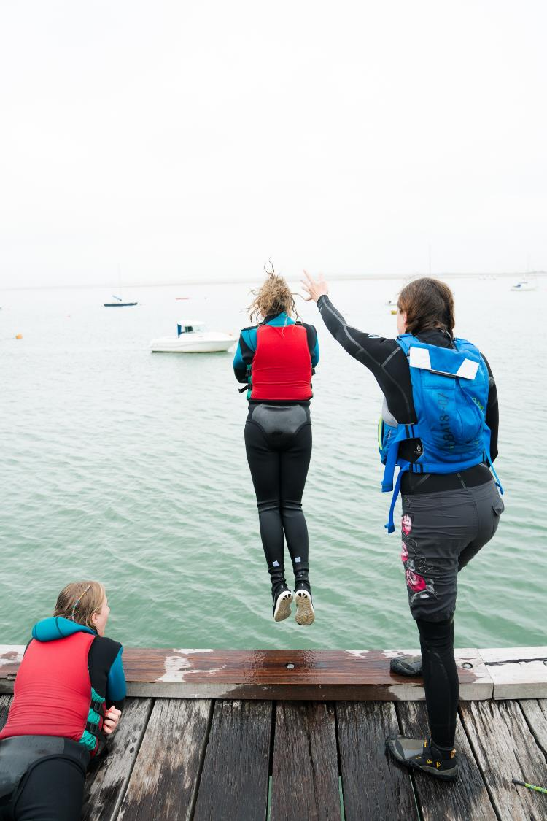
AFTER TAKING PART IN OUTWARD BOUND:
83% of young people said they felt more confident about what they could achieve in school.
97% said the course had had a positive effect on their personal development, identifying increased confidence and self-esteem as the key benefits
87% of students said their Outward Bound course has taught them to keep trying when things don’t work out

Slide 18
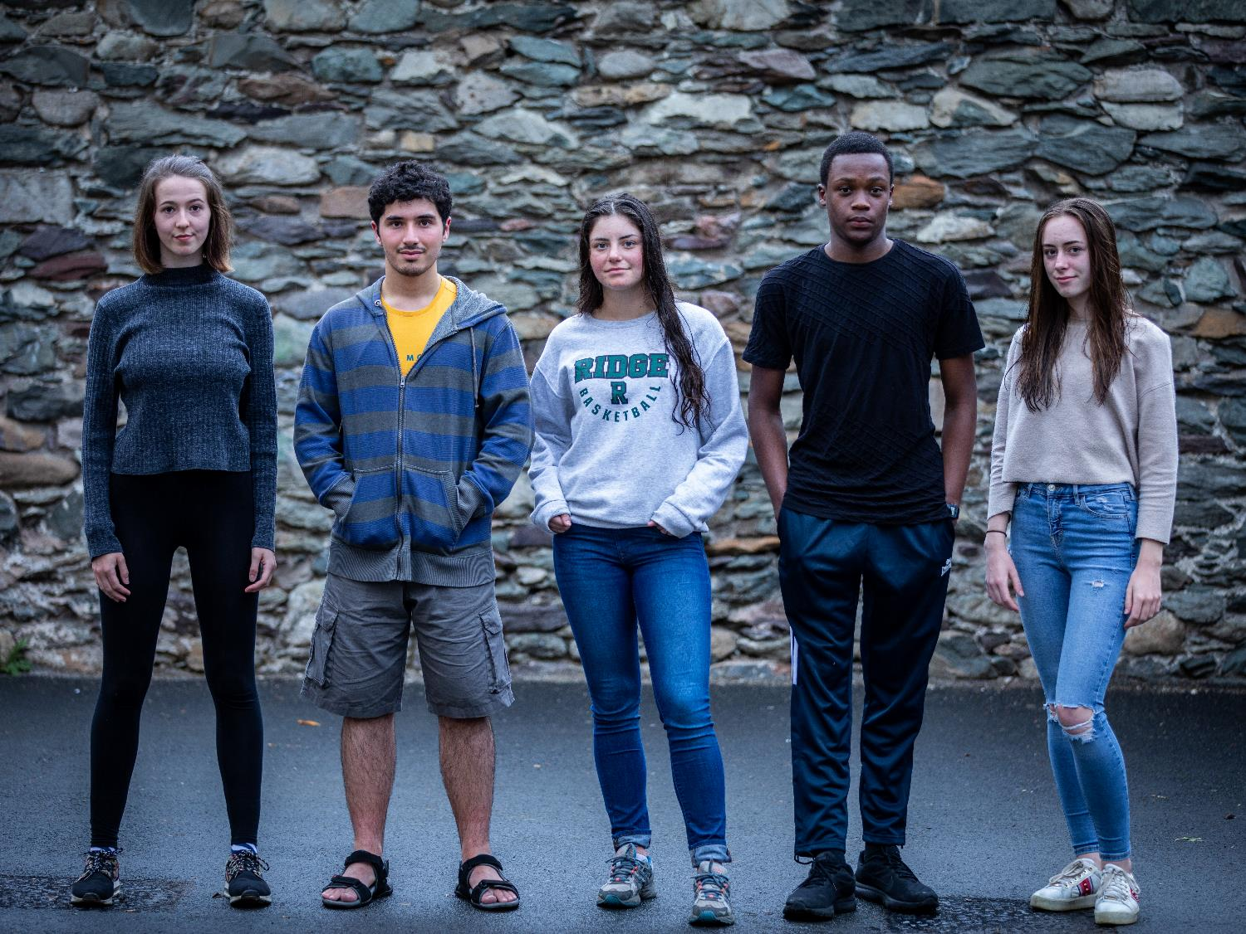
Thank YOU
With your help and support, we can change young people’s lives for the better.
Presenters name

