Slide 1
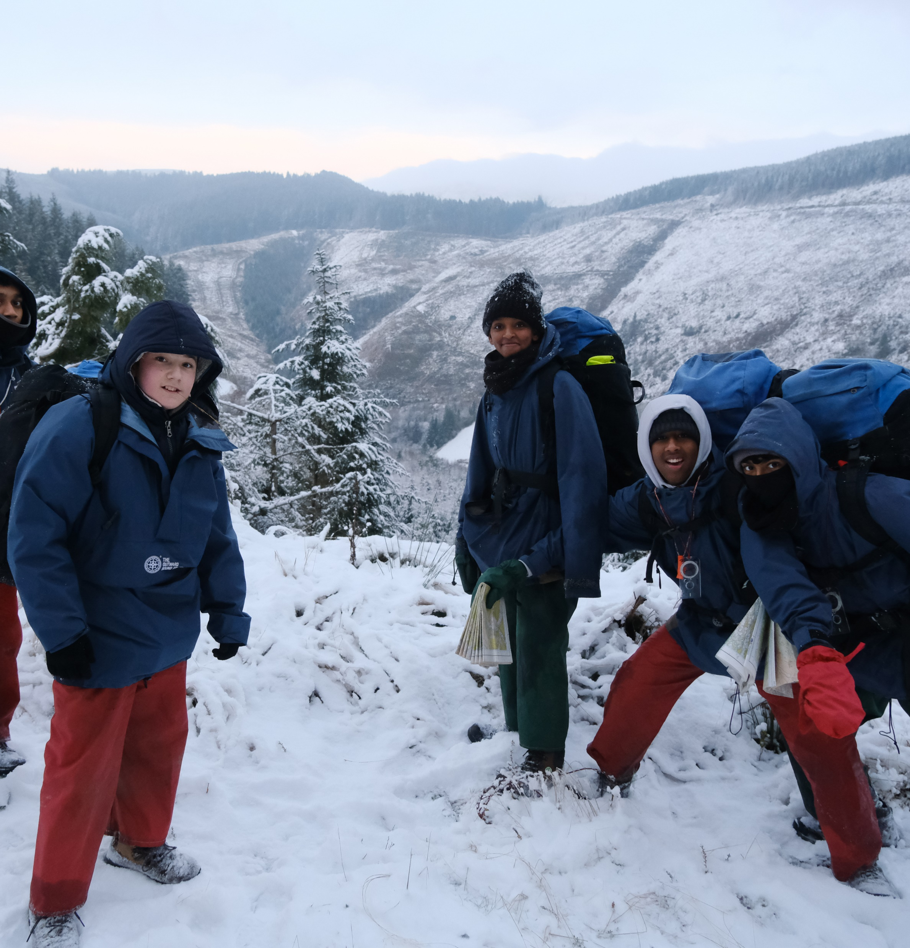
FESTIVE KNIT
DAY
INSERT DATE
£2 donation (suggested)
Help to reach my London Marathon fundraising target
Scan the QR code:
Bring the outdoors in and get your festive knit on for Outward Bound. Socks, jumpers, scarves - the more the merrier! Your support will help young people to have a life-changing adventure this Christmas.
The average young person is estimated to spend only 5% of their time outside.
^{7 in 10 have low confidence,} self-esteem, wellbeing and aspirations.

